Slide 1
Pure Intralymphatic Breast Carcinoma Following Neoadjuvant Treatment: Clinicopathologic Features and Outcome of a Rare Pattern of Residual Disease
da Costa, J.P.R.; Abreu, R.F.; Osório, C.A.B.T; Sanches, S.M.; Bittencourt, A.; Makdissi, F.B.; Tavares, M.C.; De Brot, M.
A.C.Camargo Cancer Center

Slide 2
Declaração de Conflito de Interesse
Dr(a). João Pedro dos Reis da Costa afirma ter / não ter conflito
de interesse a declarar
Em caso afirmativo, especificar: associação financeira relevante
nos últimos 12 meses e que esteja relacionada ao conteúdo da
atividade científica
Exigência da RDC Nº 96/08 da ANVISA

Slide 3
Introduction
Rarely is intralymphatic/lymph-vascular invasion the only residual disease in the breast (PIC) after neoadjuvant systemic therapy (NAST) and data in the literature are limited
Only 47 patients have been reported in 5 prior studies
Here, we sought to assess clinicopathologic features and outcome of residual PIC

Slide 4
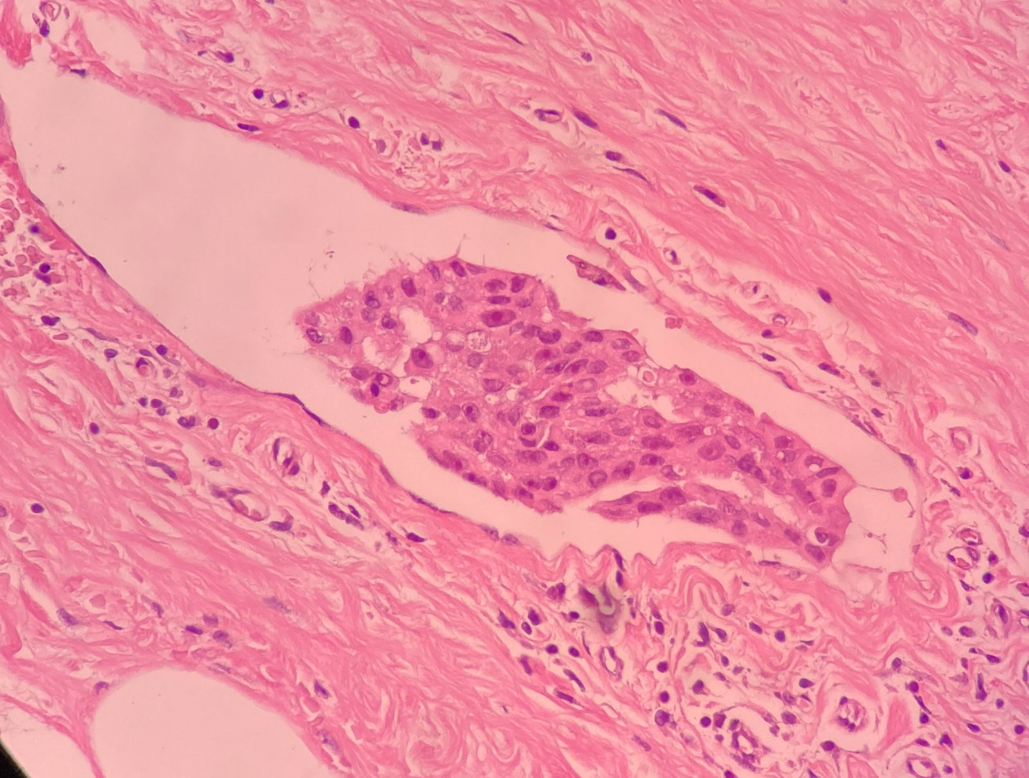
Introduction
Intralymphatic tumor was defined using Rosen’s criteria, which state that endothelial nuclei must be unequivocally recognized and that the contour of the intralymphatic tumor emboli may resemble the contour of the surrounding empty lymphatic space, but not to an exact degree as seen in tissue shrinkage artifact
Rosen PP. Pathol Annu. 1983
Image registered by
Dr Caio Vasconcellos

Slide 5
Introduction
Two unusual patterns of residual tumor:
Pure intralymphatic carcinoma: carcinoma present in lymphatic spaces without any areas of stromal invasion.
Predominantly pure intralymphatic carcinoma: residual carcinoma that predominantly involved lymphatic spaces with only a minor component of stromal invasion.
Rabban JT. Am J Surg Pathol. 2009
Image registered by
Dr Caio Vasconcellos

Slide 6
Methods
Eletronic medical records were searched to identify patients with PIC post-NAST between 2007-2023 at the Department of Pathology / A.C.Camargo Cancer Center
Clinicopathologic data were retrieved
Slides from surgical specimens were reviewed
Residual Cancer Burden calculator
Survival analysis was performed using Kaplan-Meier curves and the log-rank test

Slide 7
Results
We detected 9/1113 (0.8%) cases of PIC
Clinical features:
Average age at diagnosis was 45.5 years old (range 24-57 yo)
5 women presented with a palpable breast mass, 2 with inflammatory carcinoma, 2 with a non-palpable lesion, and 1 with occult primary breast cancer
1 patient was metastatic
7 patients had axillary LN metastasis before treatment (FNA positive)
2 cases exhibited LVI pre-NAST

Slide 8
Results
We detected 9/1113 (0.8%) cases of PIC
Pathological features:
Mean tumor size was 4.1 cm (range 0.8-13.0 cm)
4 patients with Invasive breast carcinoma of NST
4 patients with HER-2 (3+)
1 patient with bilateral invasive carcinoma of NST

Slide 9
Results / Pre-NAST
 | Histological type | IHC (ER/PR/HER2/Ki67) | Molecular intrinsic subtype | Clinical stage
Case #1 | Pleomorphic invasive lobular carcinoma | 0 / 0 / 3+ / 20% | HER2+ | cT4dN2aMx
Case #2 | Invasive carcinoma with apocrine differentiation | 0 / 40% / 3+ / 30% | Luminal B-HER2+ | cT2cN2
Case #3 | Invasive carcinoma with apocrine differentiation | 0 / 0 / 3+ / 80% | HER2+ | cT3cN2M0
Case #4 | Invasive micropapillary carcinoma | 0 / 0 / 3+ / 30% | HER2+ | cT2cN1cM0
Case #5 | Invasive breast carcinoma of NST | 95% / 5% / 1+ / 25% | Luminal B | cT4bN1M0
Case #6 | Invasive breast carcinoma of NST | 0 / 0 / 0 / 60% | Triple-negativo | cT3N+M0
Case #7 | Invasive breast carcinoma of NST | 0 / 0 / 3+ / 35% | HER2+ | cT2N0M0
Case #8 | Invasive breast carcinoma of NST | 0 / 0 / 2+ / 95% | Triple-negativo | cT1N0M0
Case #9 | DCIS nuclear grade 3 LN macrometastasis | 100%/7%/0/90% | Luminal B | cTisN2M0
Histological type and Molecular intrinsic subtype

Slide 10
Results
Following treatment, most cases (7/9; 77%) were categorized as RCB I
Size of residual intralymphatic carcinoma ranged from 0.1-40 mm (mean 5,65 mm)
Lymph nodes status
    6 patients showed no LN metastasis
  2 had micrometastasis
  1 had isolated tumor cells
  Occult primary breast cancer
        Showed 4 axillary lymph nodes with neoplastic emboli

Slide 11
Results
At a mean follow-up time of 24.5 months (1-44 mos)
All patients were alive
One patient presented locoregional progression in the intrapectoral lymph node on the right – Case 8
Macrometastasis of carcinoma, measuring 5.0 mm
Compared to the whole NAST population, PIC patients demonstrated a distinct survival (p<0.005), with better outcome

Slide 12
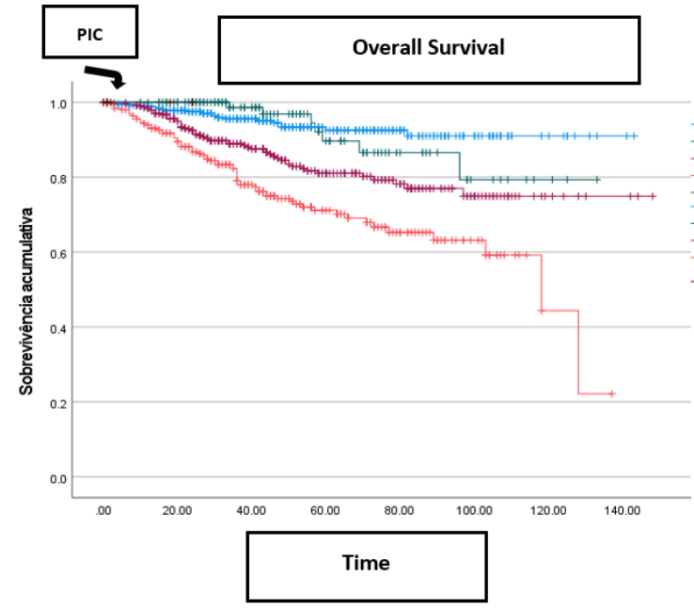
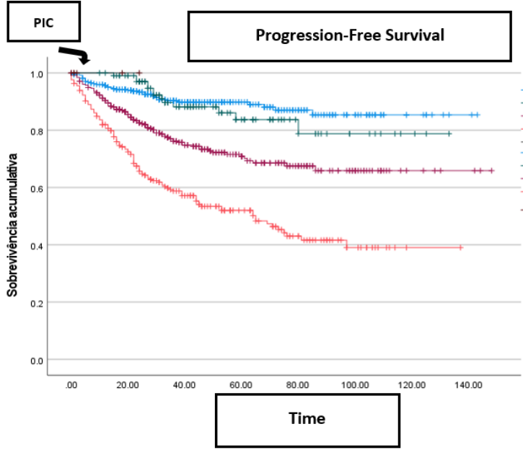
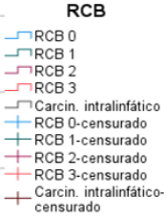
Results
Legend
However, there was no statistical difference when taking each RCB group into consideration, due to the small number of PIC cases and short follow-up time

Slide 13
Prior studies
 | Outcome
Rabban et al (2009) n = 6 | - Distant metastasis occurred in 4/6 patients - 5 patients died and 1 is alive without evidence of disease - 3-fold higher risk for death, independent of overall tumor stage
Cheng et al (2017) n = 6 | - 4/6 patients developed distant metastases - Significant greater risk for relapse (hazard ratio, 10.18 [1.97, 52.58]; p = 0.006)
Guilbert et al (2018) n = 18 | favorable outcome, with 72% (13/18 patients) alive and disease-free at a mean follow-up of 63.8 months .
MacColl et al (2021) n = 5 | -1 patient (ypN0) died of metastatic disease 25 months post-mastectomy -1 patient with contralateral invasive breast carcinoma of NST 9y after prior mastectomy -3 patients alive without evidence of disease (follow up: 71, 83, 83 mo, respectively)
Lee et al (2024) n = 12 | The residual PIC component was associated with regional lymph node metastasis 5 patients developed recurrence Two of the three patients with residual nodal disease died of cancer

Slide 14
Conclusions
PIC is an extremely rare pattern of residual disease after NAST
Half of breast cancers were HER2+ with an advanced clinical stage at diagnosis
Overall good outcome of the patients followed
The case with local recurence was at the right side of a bilateral carcinoma with triple-negative molecular subtype.
A longer follow-up time is required to determine and better understand the prognosis of this cohort

Slide 15
Thank you

